Slide 1
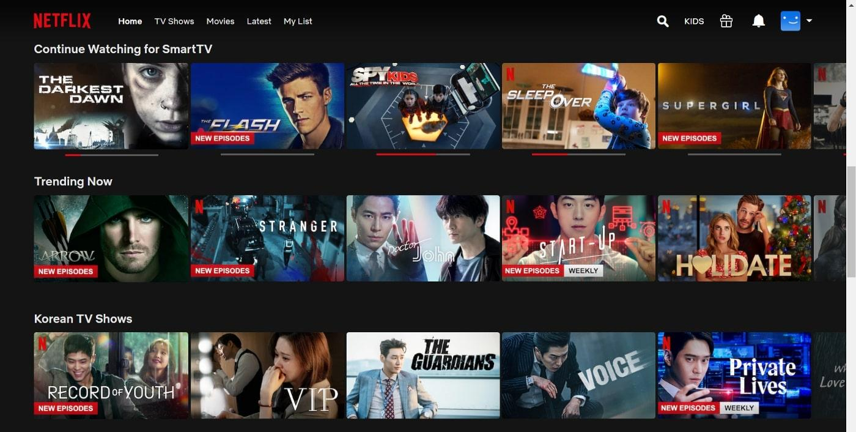

NETFLIX DATA ANALYTICS PROJECT PRESENTATION
PRESENTED BY:
RISHABH KUMAR

Slide 2


TABLE OF CONTENTS
Summary of Project.
KPI List.
EXCEL Dashboard.
POWER BI Dashboard.
Tableau Dashboard.
Python Queries.
Conclusion.
Key Insights.

Slide 3

SUMMARY OF THE PROJECT
This research examines the Netflix dataset to identify patterns in content distribution, genres, ratings, release dates, and country-specific availability.
The analysis uses Excel, Python, Tableau and Power BI to turn raw data into interactive dashboards and actionable insights, allowing for data-driven decision-making and showcasing practical abilities in data cleansing, visualization, and business analysis.

Slide 4

KPI LIST
Total Titles.
Total locations.
Total Genre.
Total Ratings.
Total Directors.
Movies vs TV Shows.
Content By Countries

Slide 5

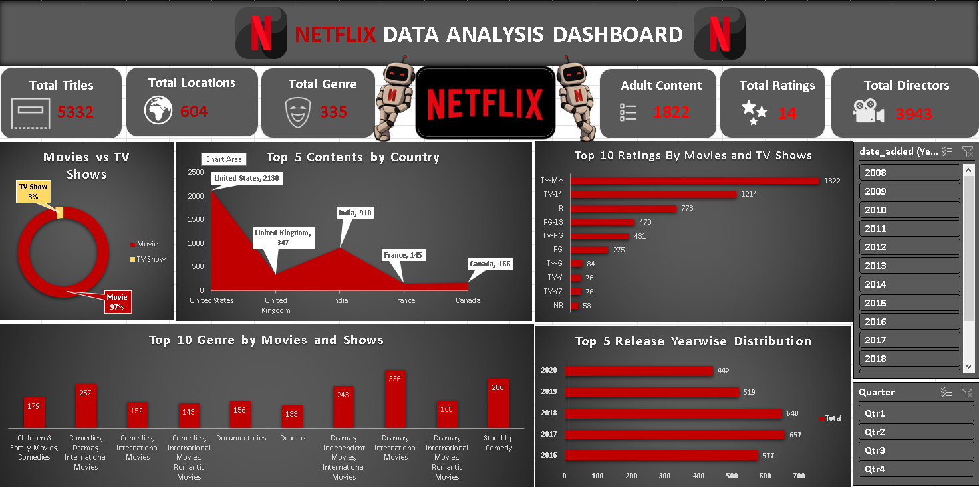
EXCEL DASHBOARD

Slide 6

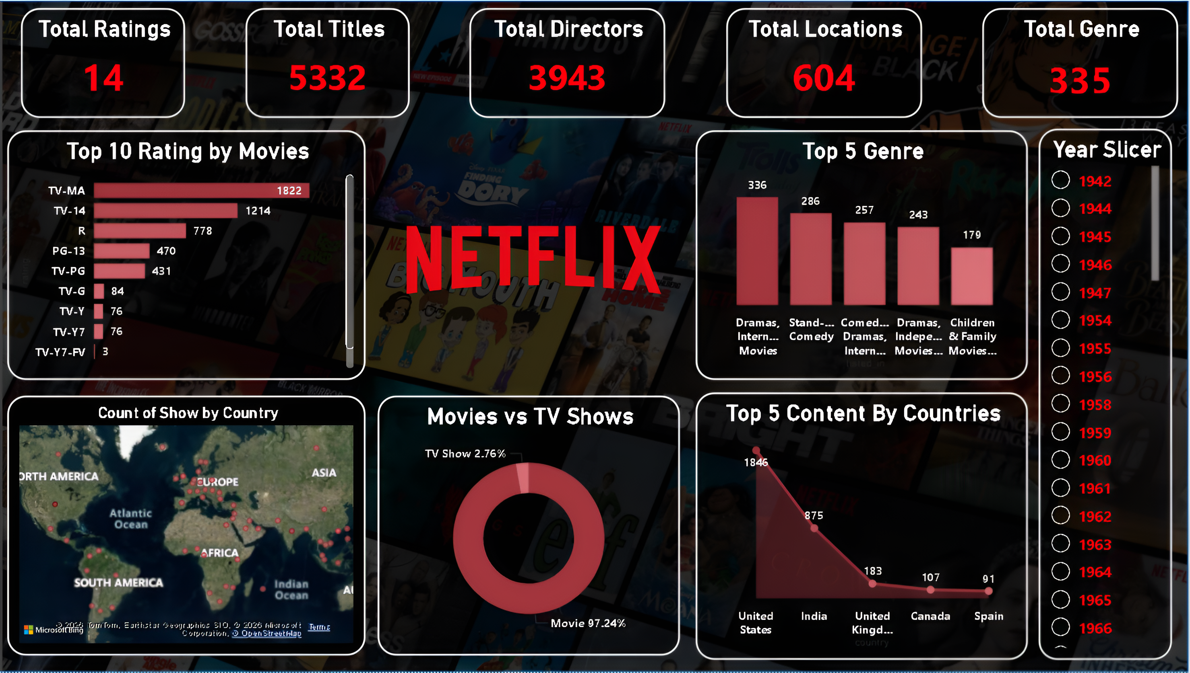
POWER BI DASHBOARD

Slide 7

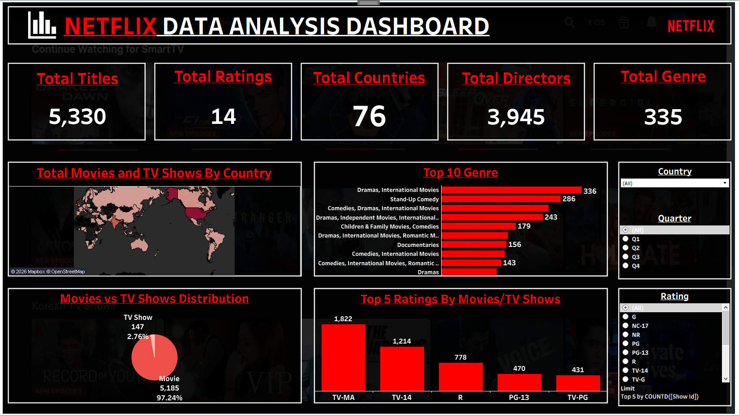
TABLEAU DASHBOARD

Slide 8

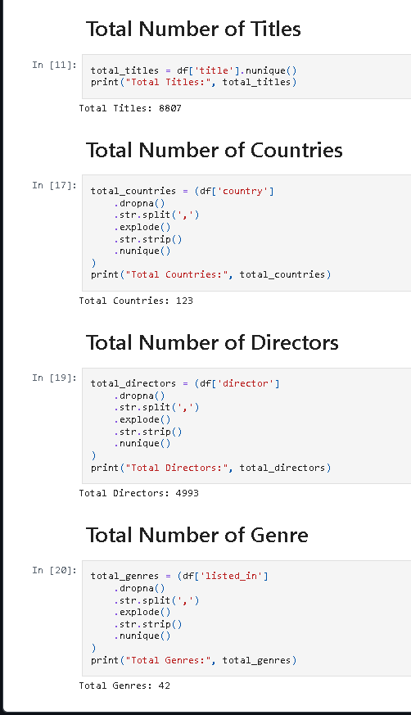
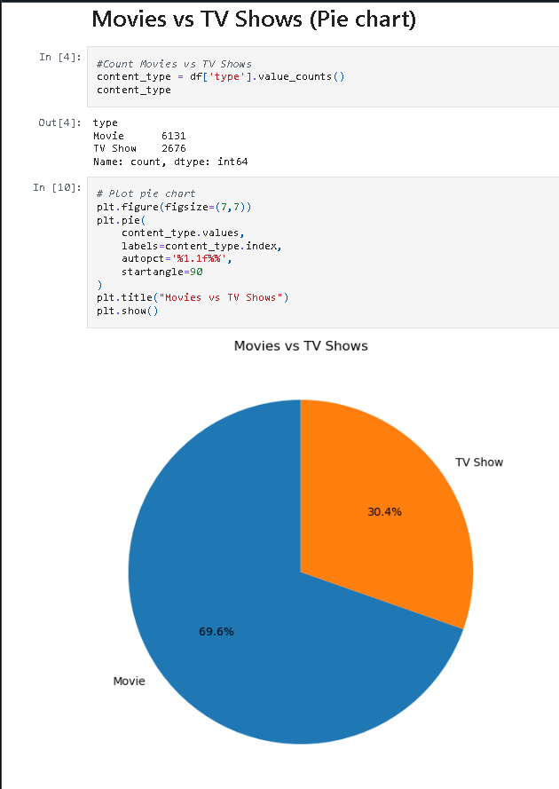
PYTHON QUERIES (Part 1)

Slide 9
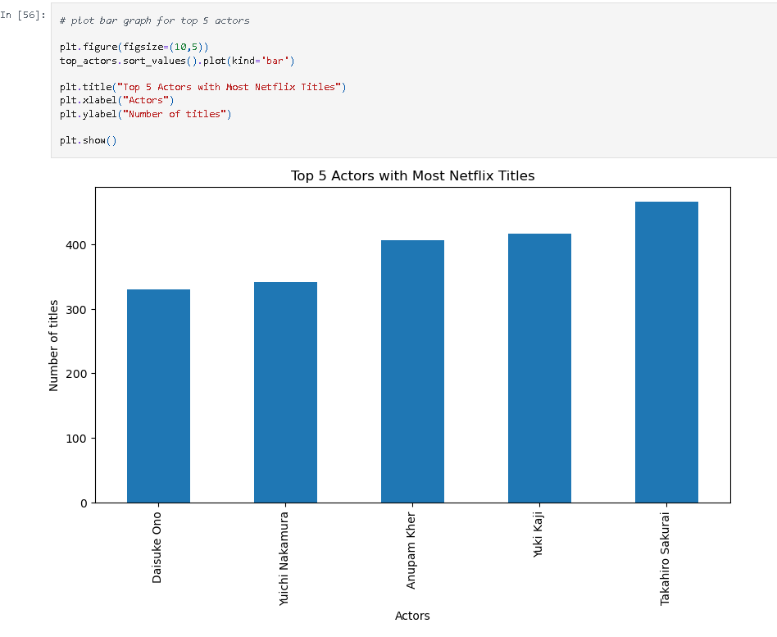
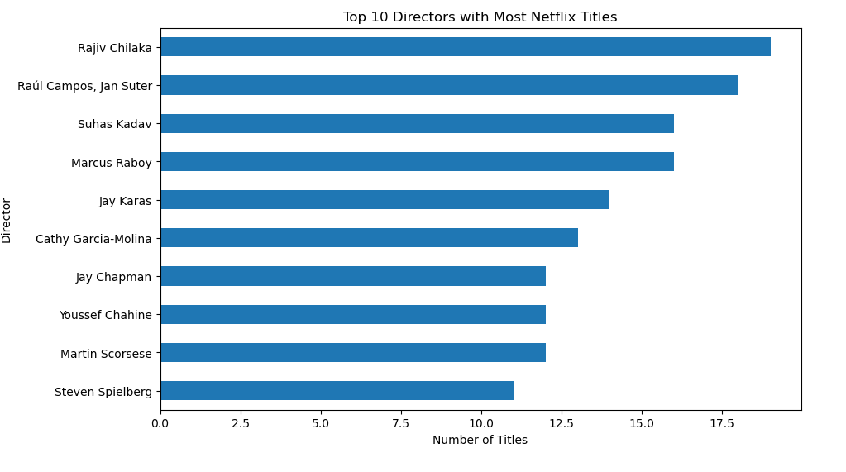
PYTHON QUERIES (Part 2)

Slide 10

KEY INSIGHTS
The research suggests that movies outweigh TV shows on Netflix, with the United States producing the most material. Drama and international genres dominate the platform, and content development has increased dramatically since 2015. The majority of titles are aimed at older audiences, demonstrating Netflix's commitment to varied, internationally accessible entertainment.

Slide 11

CONCLUSION
The Netflix data analysis identifies important patterns in content distribution, genres, ratings, release dates, and global availability. The project showcases data-driven decision-making and practical analytical abilities by translating raw data into useful insights using Excel, SQL, Python, and Power BI. This allows for informed business strategies and successful content planning.

Slide 12

THANK YOU

